Slide 1



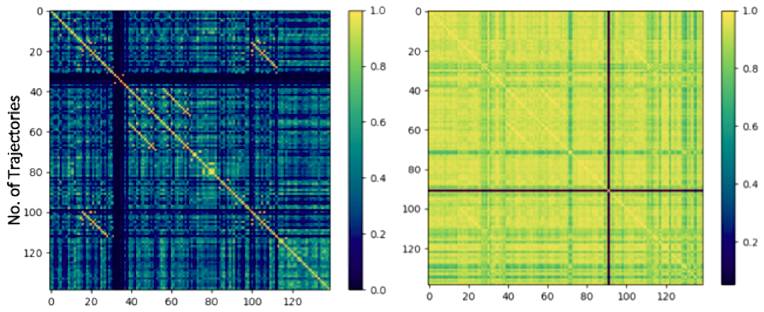
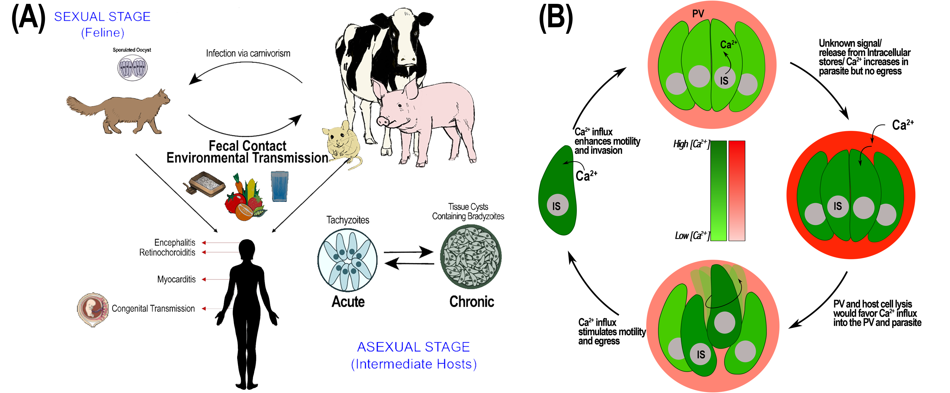
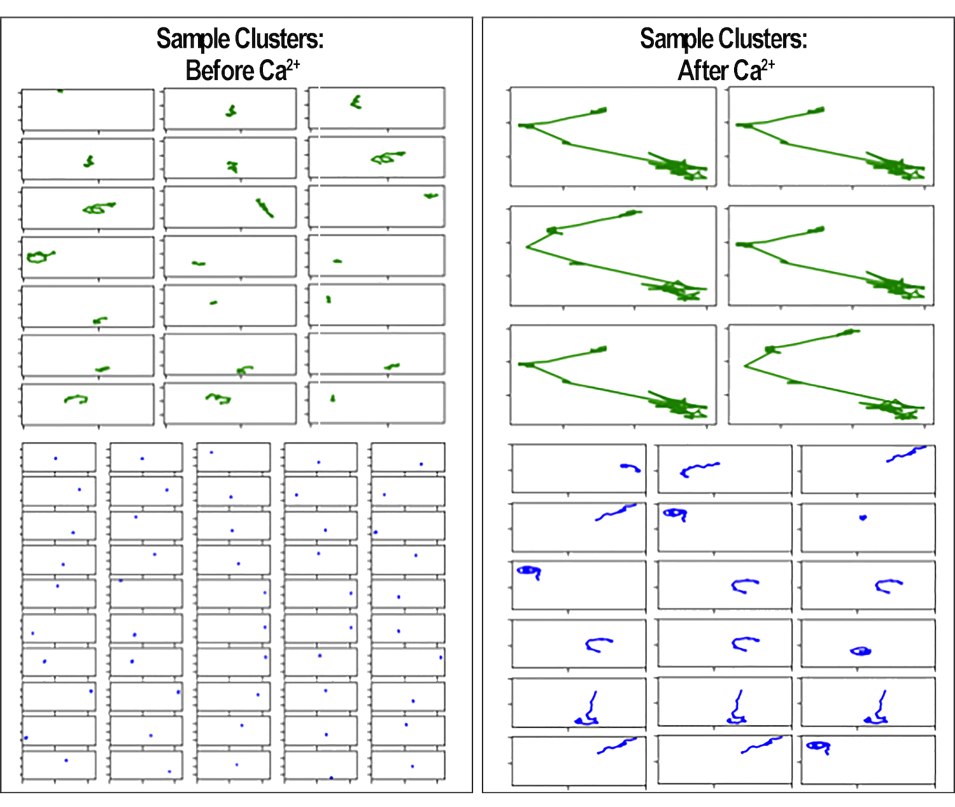
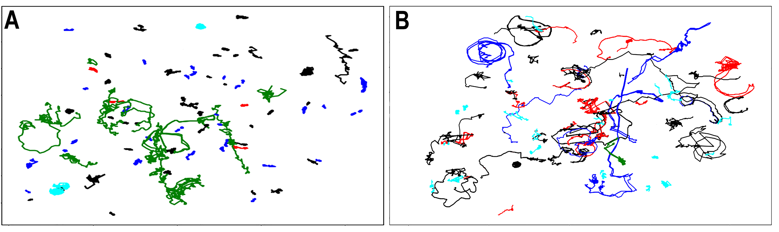
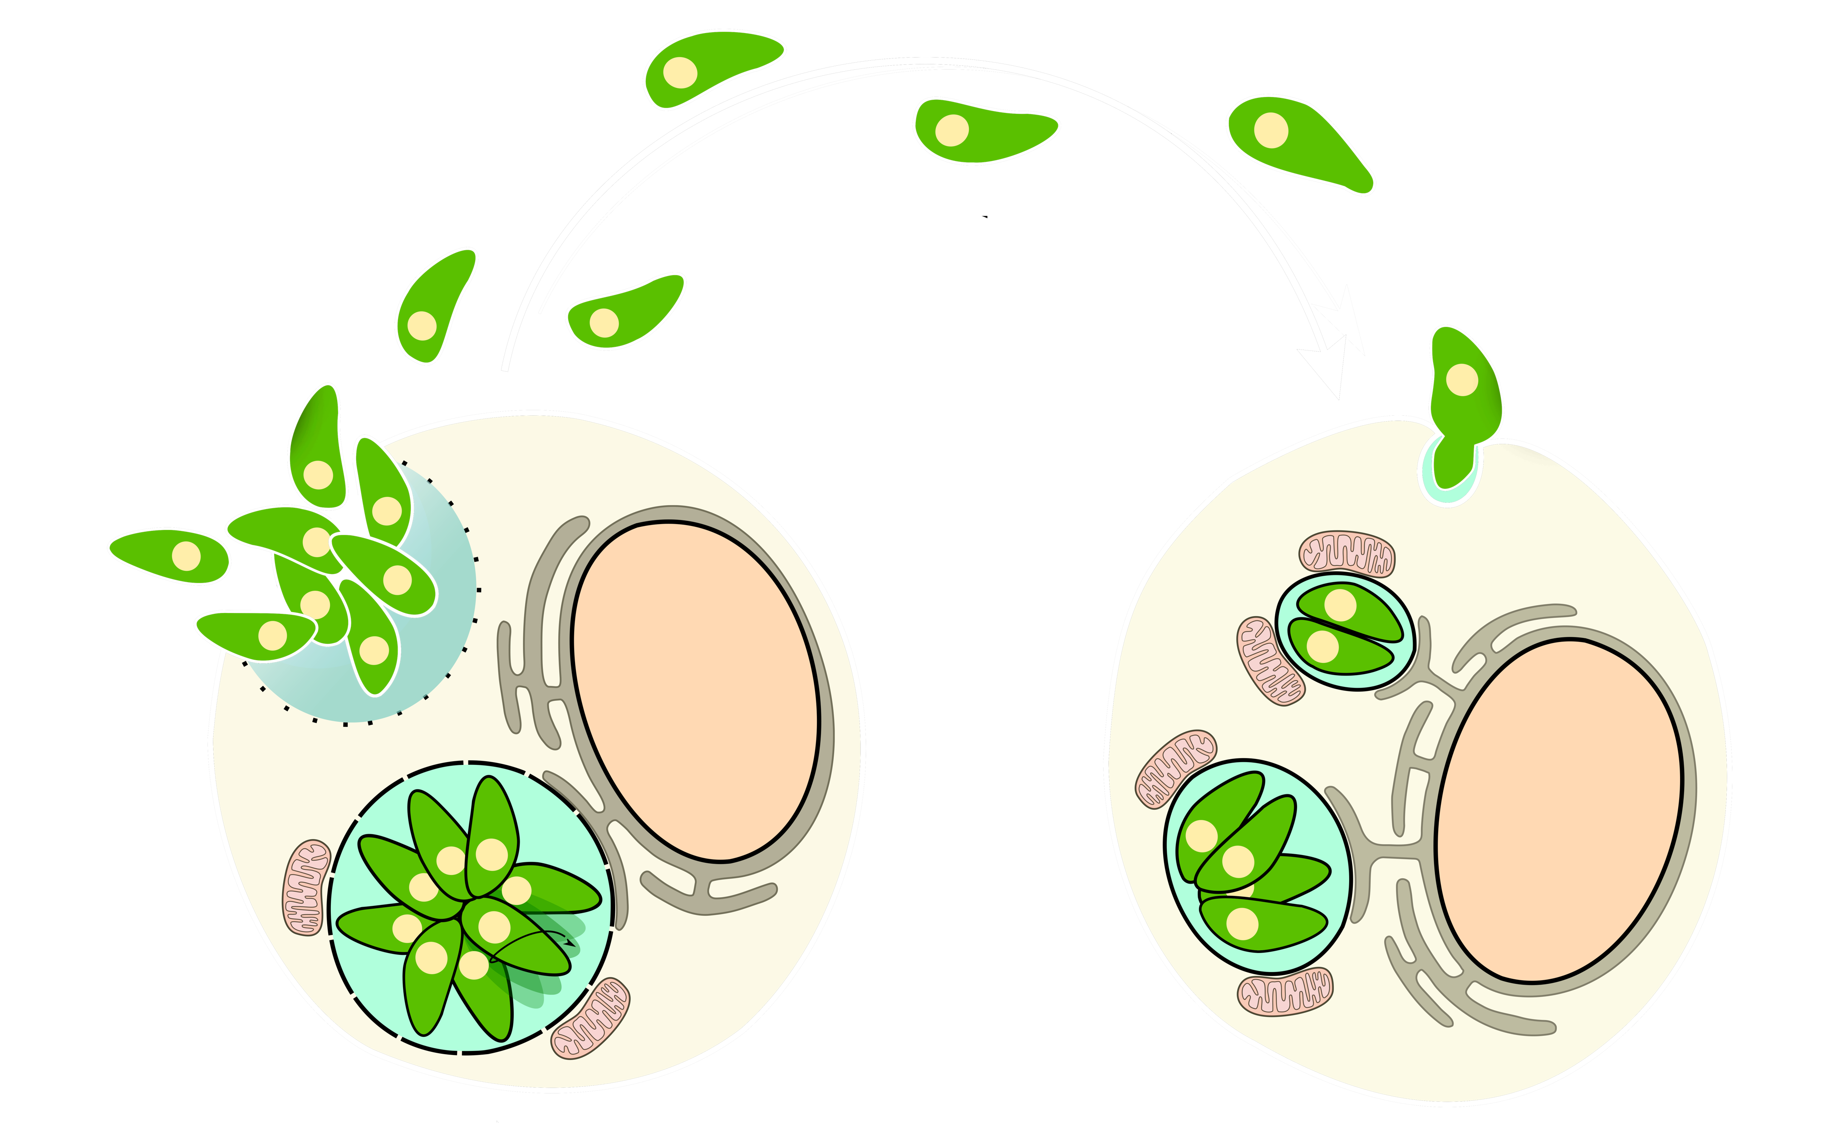
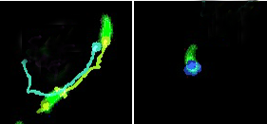
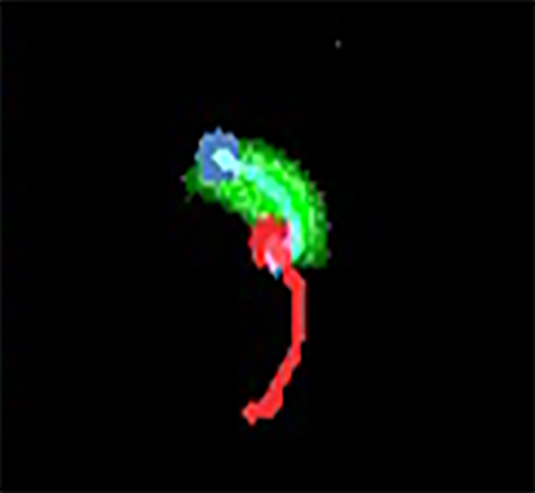
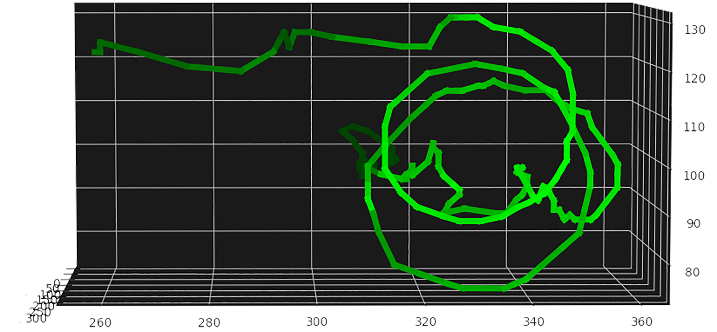
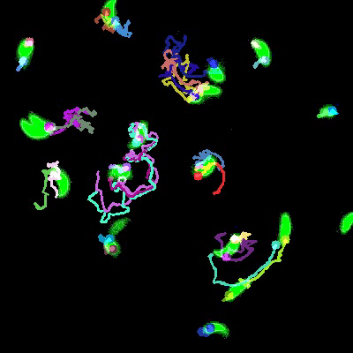
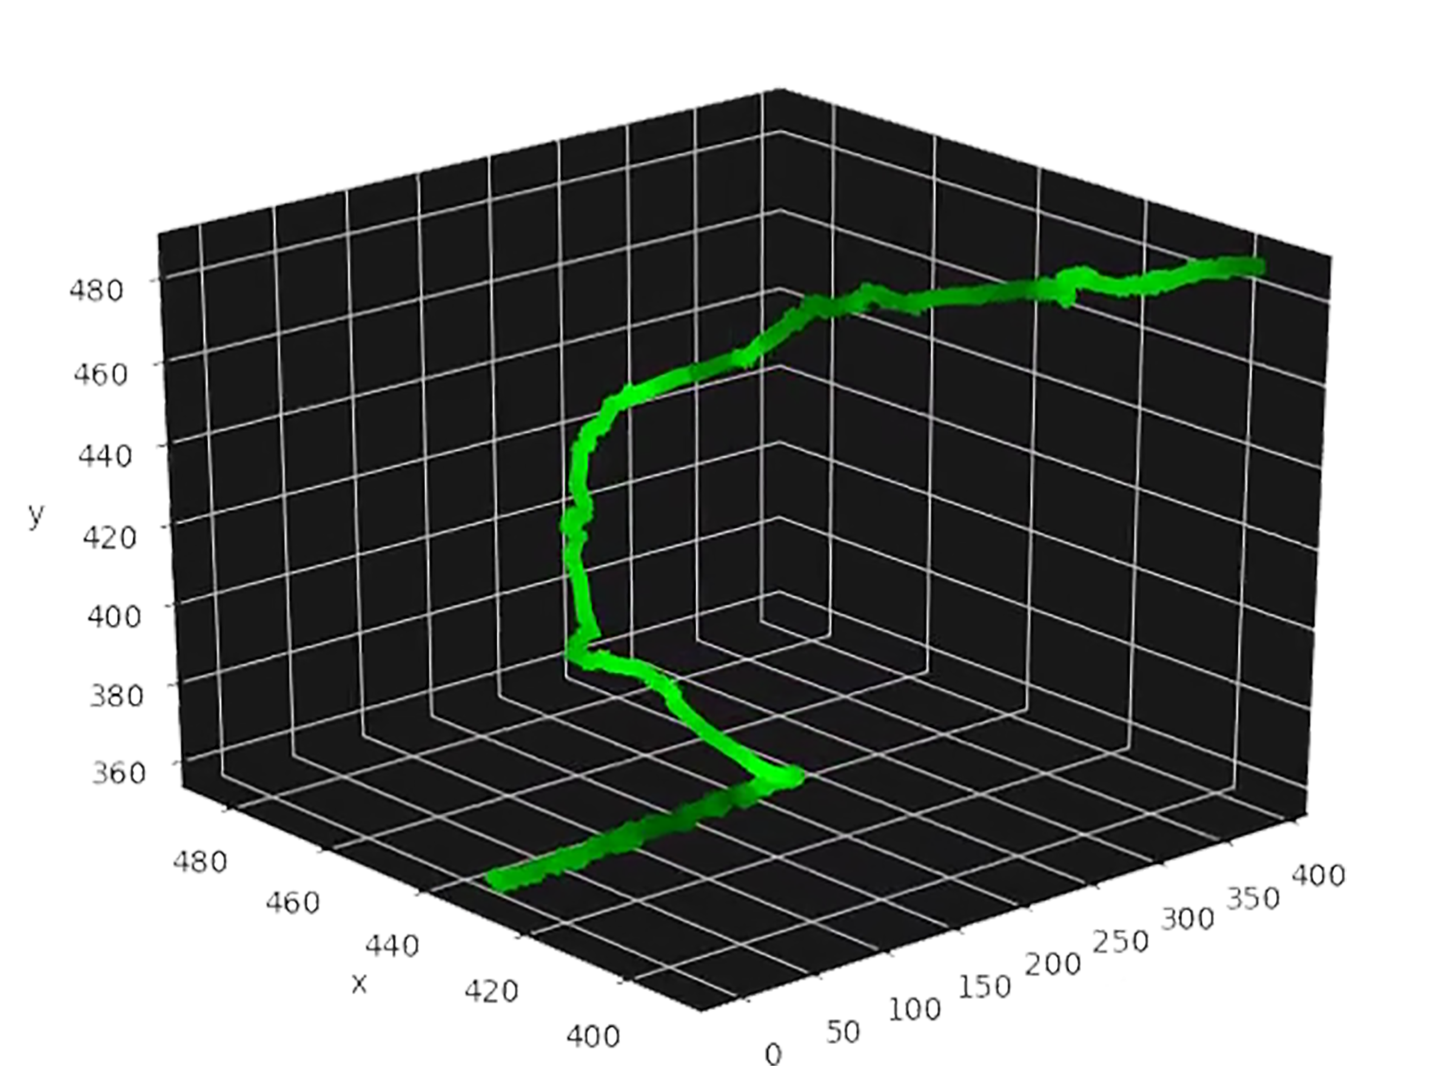
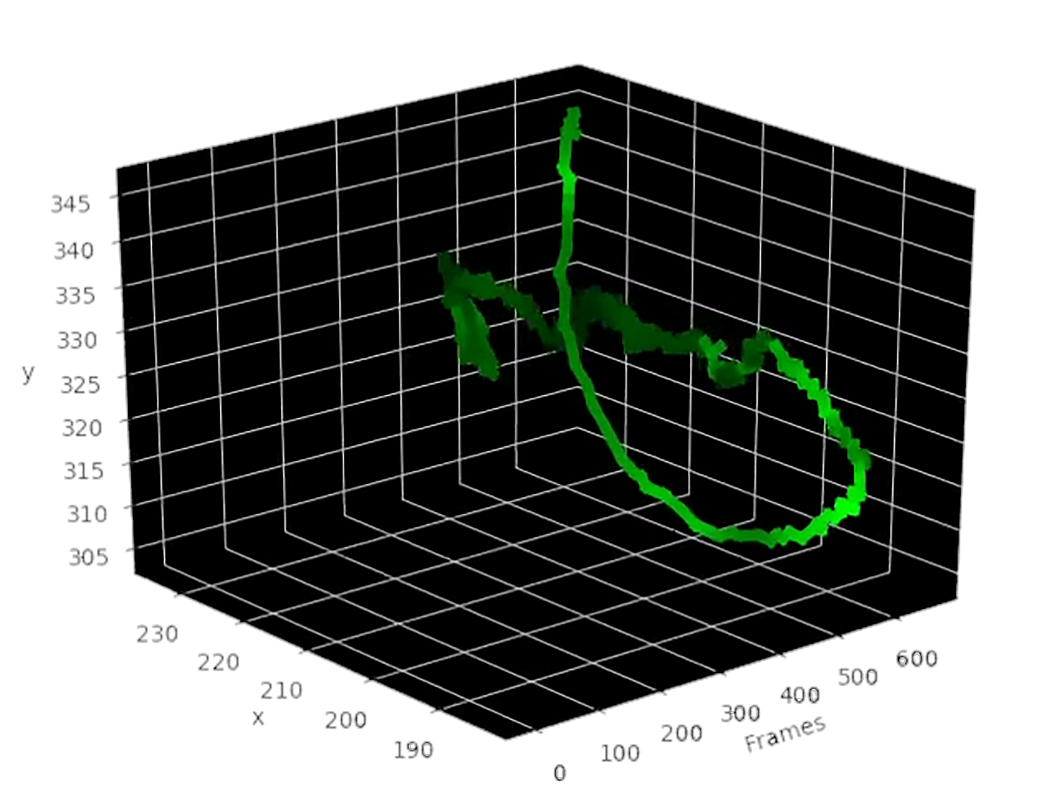
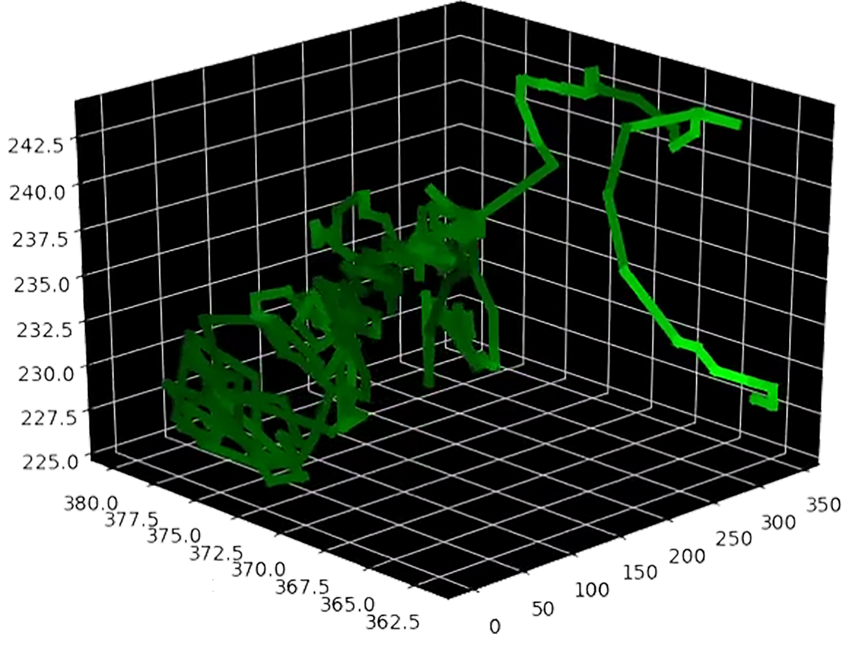
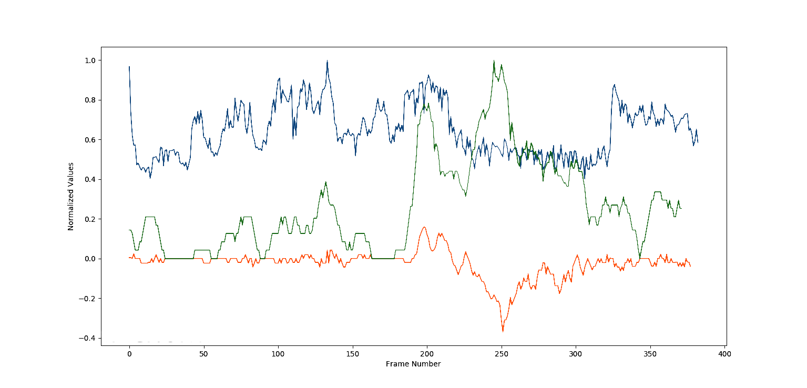
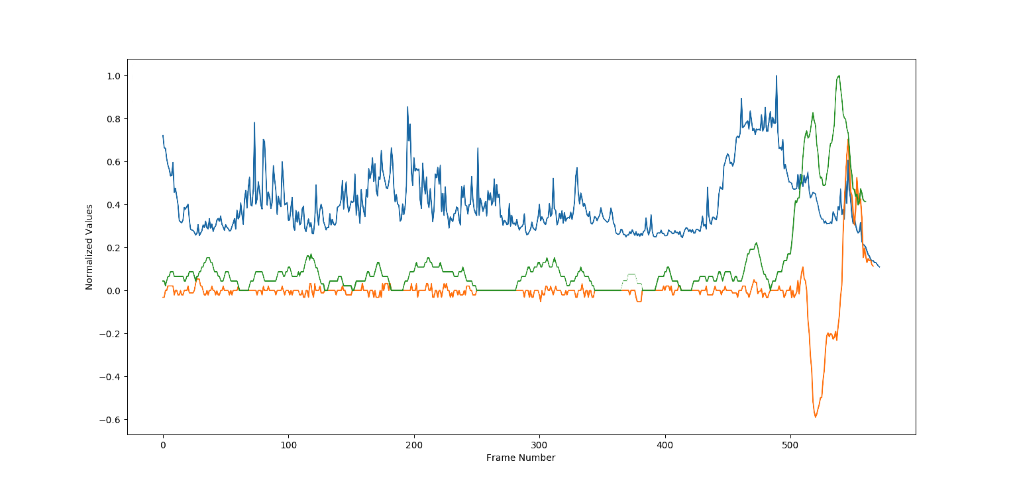
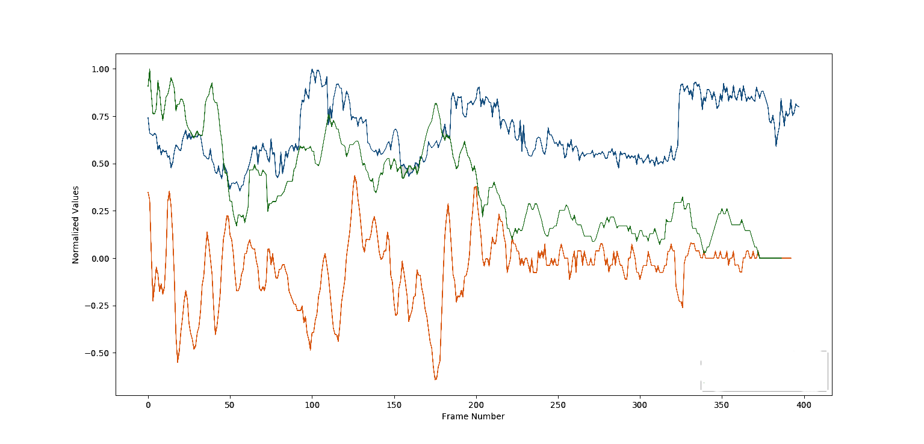
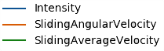
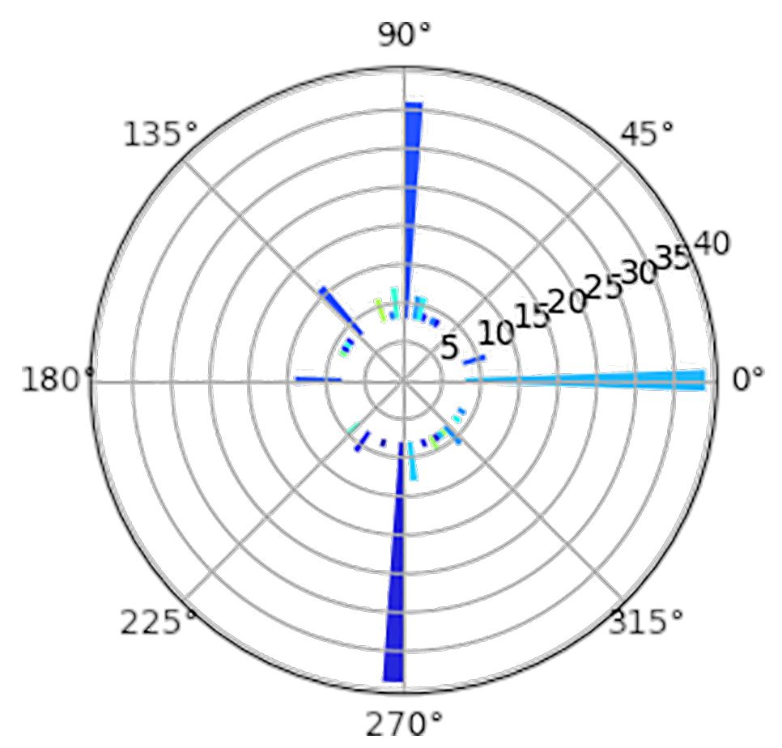
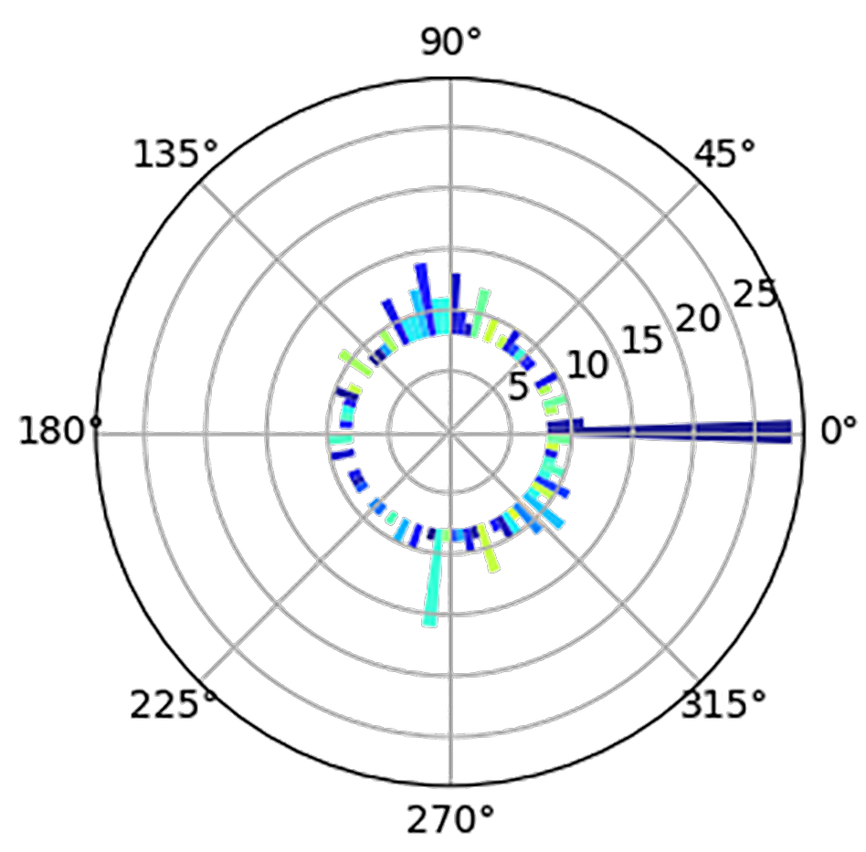
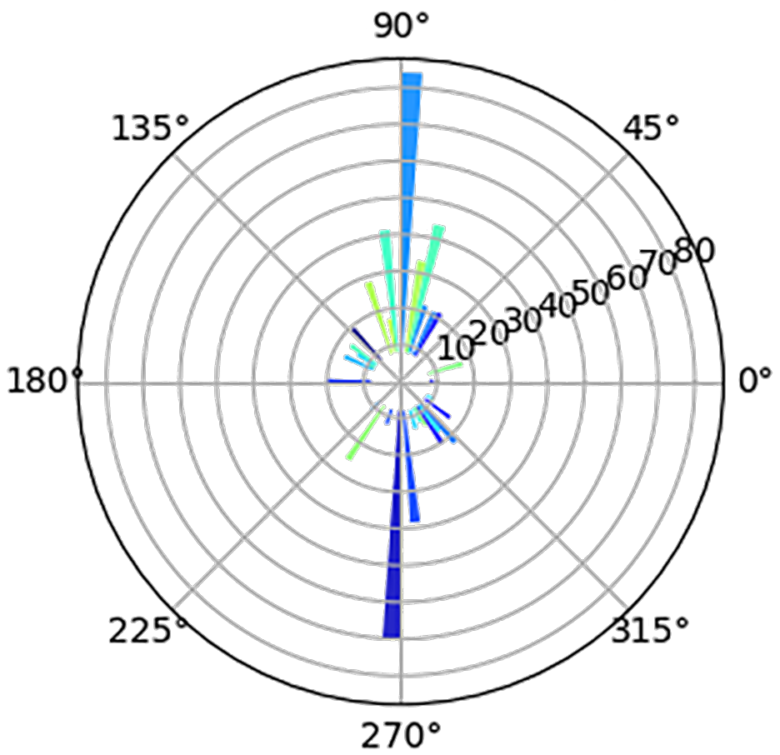
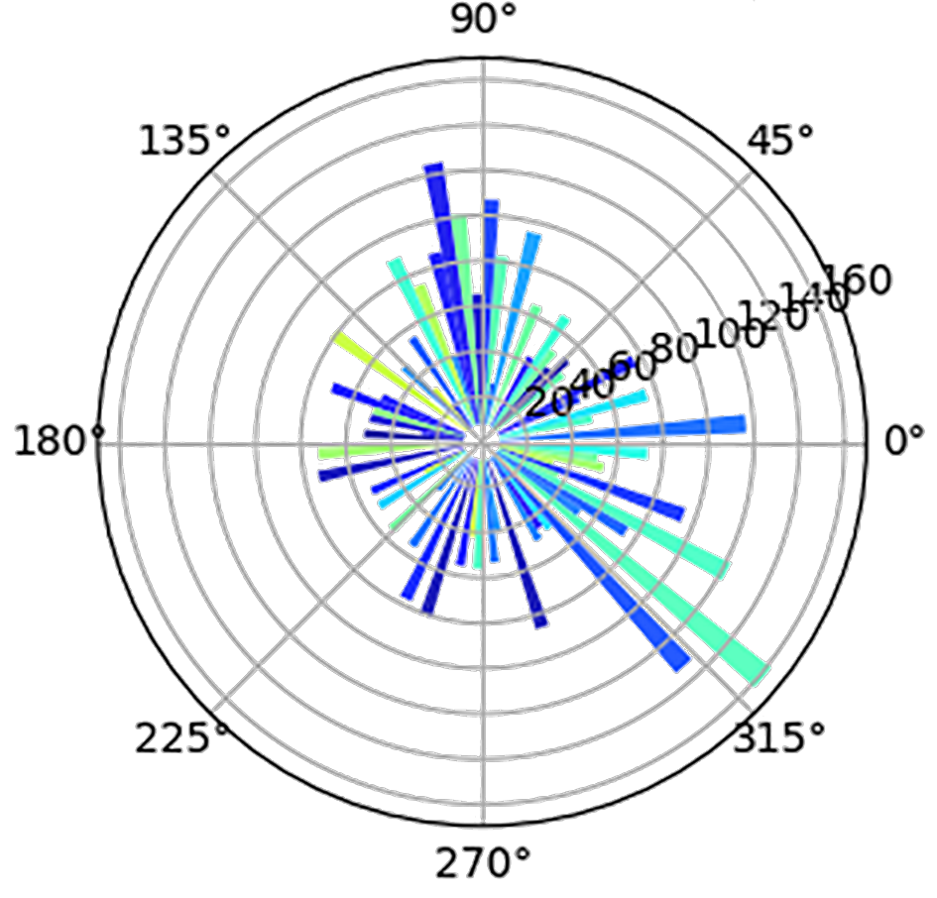
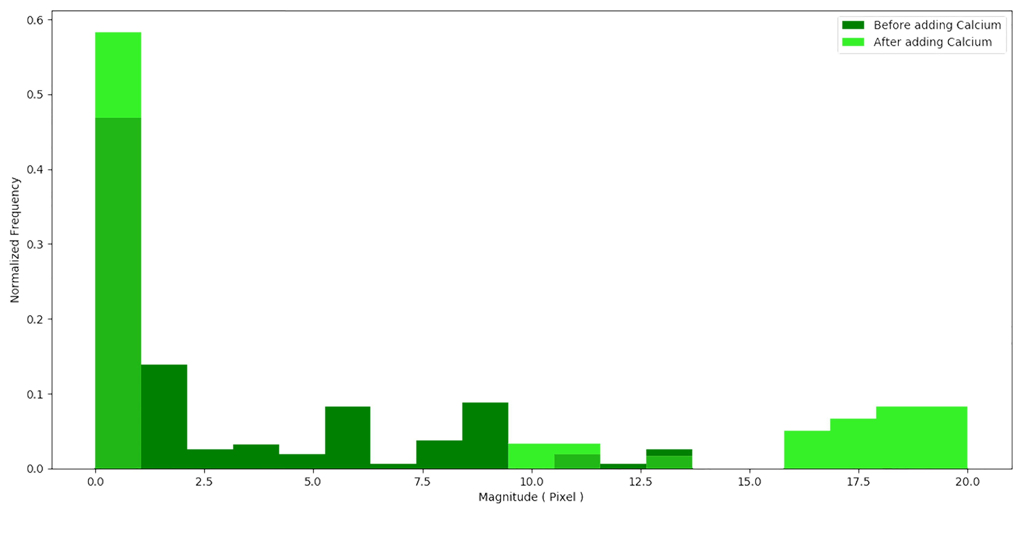
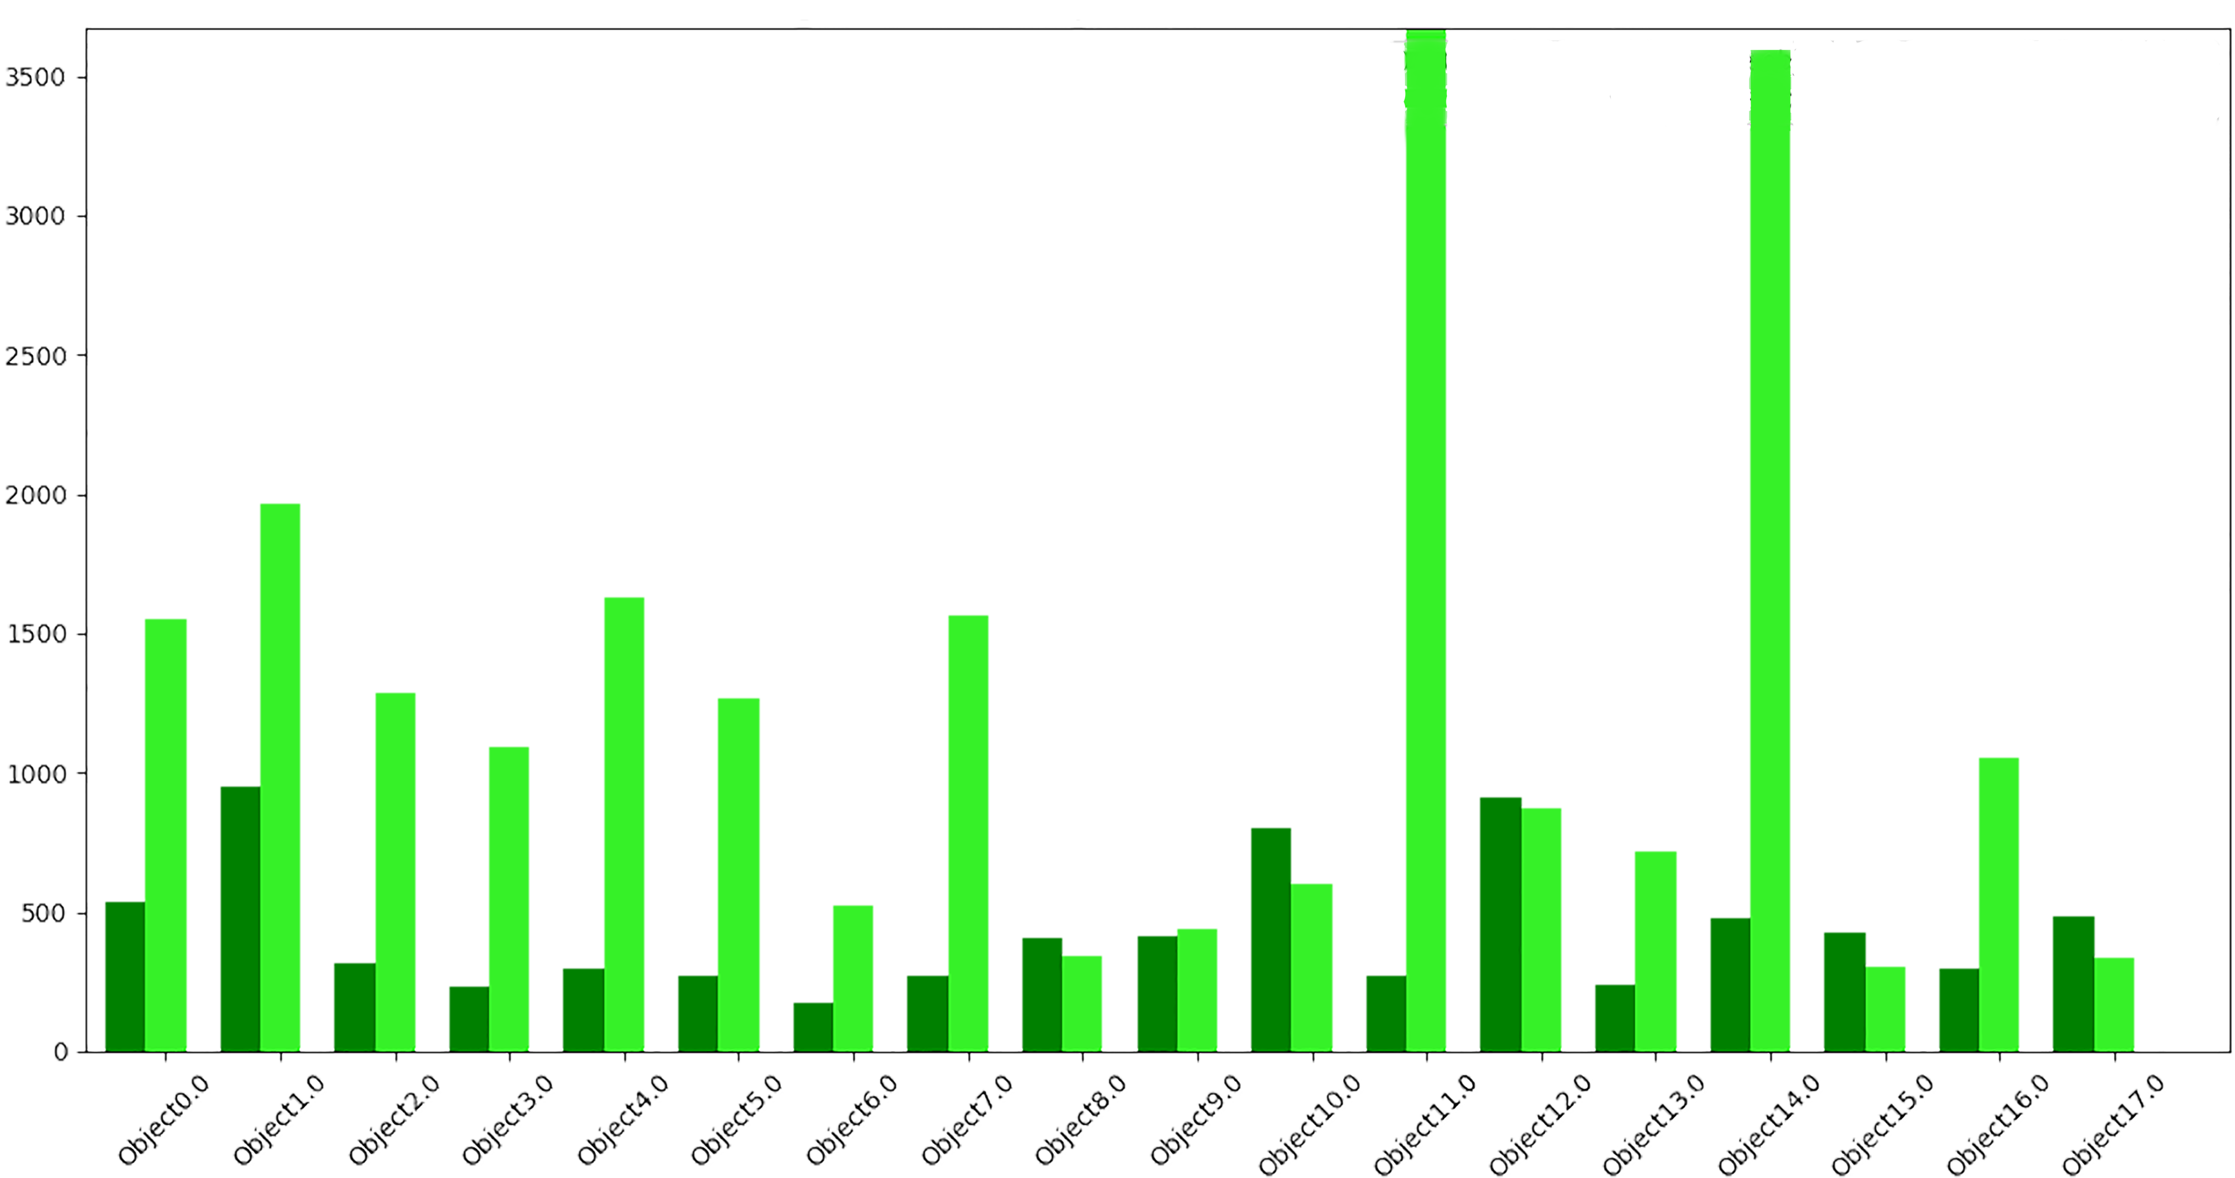
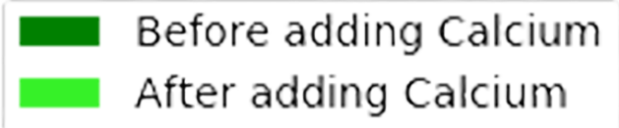
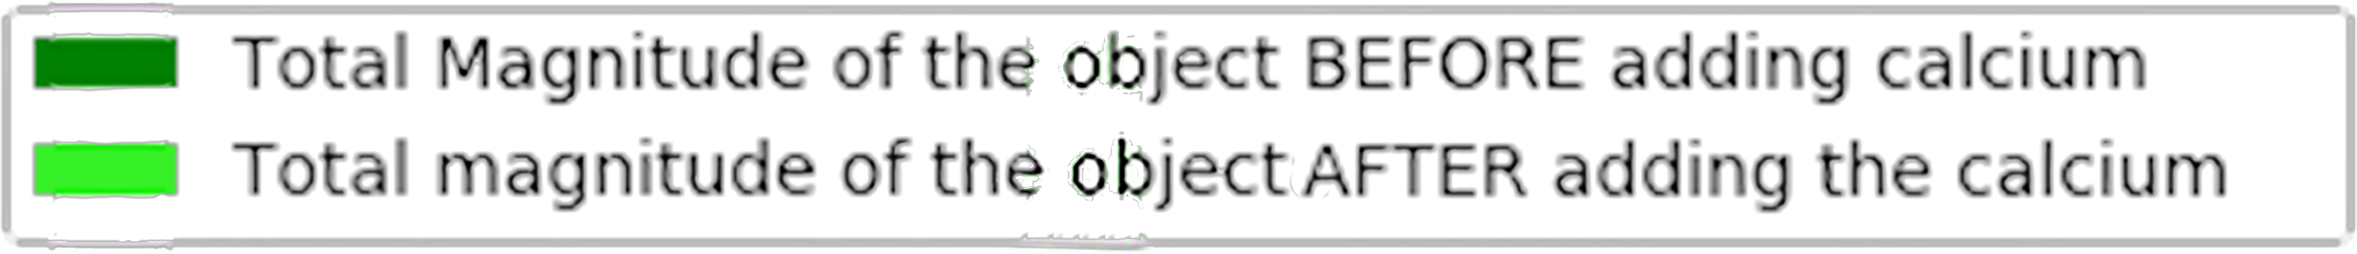
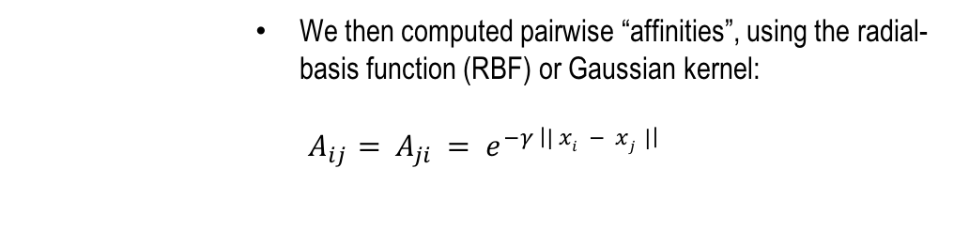
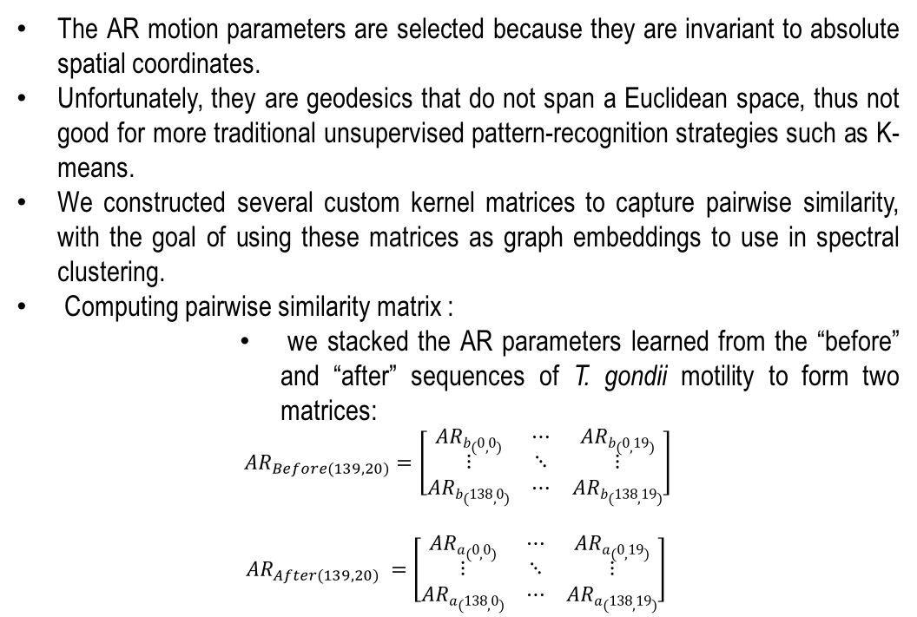
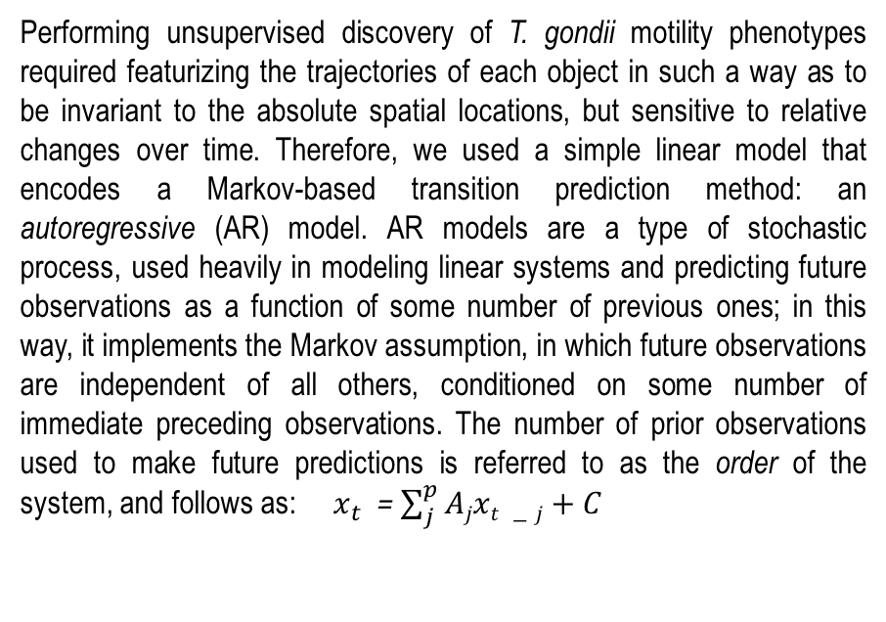
Unsupervised Discovery of Toxoplasma Gondii Motility Phenotypes
Mojtaba S. Fazli*, Stephen Vella**, Silvia N.J. Moreno**, Shannon Quinn*,**
*Department of Computer Science, University of Georgia
**Department of Cellular Biology Center for Tropical and Emerging Global Diseases, University of Georgia,
Athens, Georgia 30605, United States of America
Abstract:
Pipeline:
Establishing Pairwise Motion Similarity
Toxoplasma gondii is a parasitic protozoan that causes disseminated toxoplasmosis, a disease that afflicts roughly a third of the worlds population. Its virulence is predicated on its motility and ability to enter and exit nucleated cells; therefore, studies elucidating its mechanism of motility and in particular, its motility patterns in the context of its lytic cycle, are critical to the eventual development of therapeutic strategies. Here, we present an end-to-end computational pipeline for identifying T. gondii motility phenotypes in a completely unsupervised, data-driven way. We track the parasites before and after addition of extracellular Ca²⁺ to study its effects on the parasite motility patterns and use this information to parameterize the motion and group it according to similarity of spatiotemporal dynamics.
Figure 3) Broadly, we imported 10 videos, preprocessed them, and extracted the motility statistics, and parasite trajectories using our tracking algorithm.
Then we used a linear model that encodes a Markov based transition prediction method: an autoregressive (AR) model which represents a parameterization of the system that is not sensitive to absolute spatial position. In next step the similarity matrix is created and finally the spectral clustering is applied to group the similar motion trajectories.
Raw Videos Data
The AR motion parameters are selected because they are invariant to absolute spatial coordinates.
Unfortunately, they are geodesics that do not span a Euclidean space, thus not good for more traditional unsupervised pattern-recognition strategies such as K-means.
We constructed several custom kernel matrices to capture pairwise similarity, with the goal of using these matrices as graph embeddings to use in spectral clustering.
Computing pairwise similarity matrix :
we stacked the AR parameters learned from the “before” and “after” sequences of T. gondii motility to form two matrices:
$${AR}_{Before(139,20)}=\left[\begin{matrix}ARb(0,0) & ⋯ & ARb(0,19) \\ ⋮ & ⋱ & ⋮ \\ ARb(138,0) & ⋯ & ARb(138,19)\end{matrix}\right]$$
$${AR}_{After(139,20)} =\left[\begin{matrix}ARa(0,0) & ⋯ & ARa(0,19) \\ ⋮ & ⋱ & ⋮ \\ ARa(138,0) & ⋯ & ARa(138,19)\end{matrix}\right]$$
Optical Flow-
KLT Tracker
Preprocessing
Life Cycle and Ca²⁺ Homeostasis of T. gondii:
Extraction of Trajectories
Statistical Analyzation
A
B
Preprocessing on trajectories
Auto regressive Parameterization
Figure 4 : RBF kernels from AR motion parameters using gamma = 0.1, from AR motion parameters computed before (left) and after (right) addition of cytosolic Ca²⁺.
Spectral Clustering
Similarity Matrix
We then computed pairwise “affinities”, using the radial-basis function (RBF) or Gaussian kernel:
$A_{ij}=$ $A_{ji }= e^{−γ \left|| xi − xj |\right|}$
Results!
How Can We Study
The Motion Model
in a Live, Motile
Parasite?
Spectral Clustering of the Motion Phenotypes
Spectral clustering :
operates on the spectrum of the underlying graph of the data, imposed through a similarity computation using a pairwise kernel.
First, using this affinity kernel, a graph Laplacian is computed.
Second, the principal eigenvectors of that graph are used to embed the original data in a low-dimensional space
Now we can use the simpler clustering strategies such as K-means to sepearte the groups.
Using established heuristics from previous work on the T. gondii parasite and its lytic cycle, we chose k = 5 clusters for our analysis.
Figure 5 shows a summary of the clustering results. The left column (A) indicates trajectories from before the addition of Ca²⁺, and the (B) column shows the grouping samples after Ca²⁺ addition. Each subfigure is a single object, illustrated by a line showing the extent of its movement over the 150-frame duration of the segment.
A
B
C
Figure 1 A) Toxoplasma Life Cycle. Sexual replication only occurs within cats. Sporulated oocysts are shed into the environment via cat feces. Within intermediate hosts, such as humans, tachyzoites account for acute infection. Bradyzoites are formed from tissue cysts and contribute to life-long infection. Uncontrolled lytic cycle growth can cause secondary complications. (Image adapted from Christina Moore). B) Model of Ca²⁺ Homeostasis. Increase in Ca²⁺
stimulate lysis of host cell, causing Ca²⁺ influx from the extracellular media. Influx of Ca²⁺ leads to an activation of motility and egress. Parasites that egress
seek other host cells to invade to continue with its lytic cycle through gliding motility. Adapted from Borges et al.
KLT Tracking of Ca²⁺ Dynamics
Egress
Invasion
(I)
(II)
Helical
Circular
Twirling
A
Ca²⁺
Y
Y
Ca²⁺
Y
Ca²⁺
Helical
TG
Circular
Ca²⁺
Twirling
Ca²⁺
B
Helical
Circular
Twirling
C
Ca²⁺
TG
TG
Figure 5 A) Clustering results of trajectories before (left column) and B) after (right column) addition of cytosolic Ca²⁺. Two sample clusters are shown in each column. C) Aggregated plotting of trajectories before (top) and after (down) addition of cytosolic Ca²⁺. Each object is colored by its cluster identifier, and placed according to its original absolute spatial location.
Ca²⁺
Y
Normalized Values
X
Frames
X
Frames
X
Frames
Frames
Frames
Frames
D
+ Ca²⁺
E
+ Ca²⁺
F
Normalized Frequency
Magnitude (total pixels / video)
Parametrization of normalized KLT Trajectories
Magnitude (Pixels)
Object No.
Performing unsupervised discovery of T. gondii motility phenotypes required featurizing the trajectories of each object in such a way as to be invariant to the absolute spatial locations, but sensitive to relative changes over time. Therefore, we used a simple linear model that encodes a Markov-based transition prediction method: an autoregressive (AR) model. AR models are a type of stochastic process, used heavily in modeling linear systems and predicting future observations as a function of some number of previous ones; in this way, it implements the Markov assumption, in which future observations are independent of all others, conditioned on some number of immediate preceding observations. The number of prior observations used to make future predictions is referred to as the order of the system, and follows as: $x_{t}$ = $\sum_{j}^{p}{Ajxt −j}+C$
Conclusions/Future Directions
Unweighted
Weighted
In this work, we have demonstrated a computational pipeline for tracking, extracting, parameterizing, and clustering motion trajectories of T. gondii parasites in an initial effort to elucidate discrete patterns in the parasites lytic cycle.
This is a first step toward a mechanistic understanding of the parasites virulence as a function of its motility patterns.
We have also demonstrated the application of a linear time series (AR) model to the parameterization of two-dimensional spatial motility, and its effectiveness in clustering for recognizing gross motion patterns.
Given the relatively short tracks of the T. gondii objects, we felt AR models (i.e., a linear model) would be sufficient to parameterize motion.
This technique could be applied pretty much as-is to any trajectory analysis of discrete objects.
In the future, we anticipate refining the elements of this pipeline to extract finer-grained motility patterns. Specifically, we anticipate deep learning to be the next evolution of this pipeline: using segmentation and tracking tools such as Faster RCNN to track the objects, and parameterizing the motility sequences using recurrent neural networks instead of linear systems.
Figure 2 A) Left part shows Images of Motility Types Using the KLT Tracking Module. In right part, in (I) 4D Plot of Circular Motion trajectory Before and After Ca²⁺ Addition is illustrated and in (II) Representative Stills of The Lucas-Kanade Tomasi (KLT) Tracker is illustrated. The KLT tracker is appropriate for our target. It trackes the parasites by utilizing the spatial intensity information and the Tomasi algorithm to identify the optimal fixed points(good features) for tracking. In this approach, we defined “good features” as data extracted through the Tomasi algorithm that is fed to the KLT tracker throughout the entire course of the video. This approach is very robust and accurate against potential artifacts such as cell clumping and overlapping motion trajectories. B) Representative Images of Motility Types Using the KLT Tracking Module C) Ca²⁺ Fluorescence Tracings Versus Translational Velocity Versus Angular Velocity of Helical, Circular, and Twirling motility, respectively. average distance traveled, and intensity of each tracked parasite. D) Unweighted Radial Distribution of Trajectory Angles Before and After Ca²⁺ Addition, respectively. E) Weighted Radial Distribution of Trajectory Angles Before and After Ca²⁺ Addition, respectively. F) the left figure, shows Histogram of Circular Motility Trail Length Magnitudes Before and After
Addition of Extracellular Ca²⁺. In the right side the figure represents Summation of All Cell Trajectory Trail Lengths Before and After Addition of Extracellular Ca²⁺.

